Slide 1

client has subscribed for a term deposit or not
Banking Industry

Slide 2
V
Slide 1
Data Insights
Problem Statement and Business Overview
Model Building
Metric Evaluation & Patterns
Data Pre Processing and Feature Engineering
Summary
AGENDA

Slide 3

Business Strategies and Problem Statement
Every business needs to be in top in every domain but the problem with any industry is the business conversion rate which will be driving factor too .
A term deposit is a deposit held at a financial institutes that has a fixed term . The money invested by the client (customer) is agreed for a fixed rate of interest over a fixed amount of time or term . Term deposit is extremely safe investment and are therefore very appealing to conservative , low-risk investors.
The goal of this project is to perform post-campaign analytics to identify the potential subscribers of the term deposit product for further campaigns.

Slide 4
DATA PRE-PROCESSING and Feature Engineering
Data Pre-Processing
Feature Engineering
Variables Extraction
Three Datasets were clubbed and a final data frame of 45211 datapoints and 17 variables including target.
The columns which were dropped are:
Balance
Default
Pdays
age
A new Features are been extracted based on the existing variables.
New Features are:
Ncampaign,
Nduration,
Npdays,
Nprevious,
Nbalance and
Nday
By using the correlation plot between the various extracted variables and the target variables.
Even the chi-square analysis to take only the important variables into consideration.

Slide 5
Feature Engineering
Ncampaign
Convert them to more
recent, recent and lastly
Nbalance
Converting the Balance
-Inf,0,25000,Inf
Converted them into
negative, low, high
Nduration
Converting the seconds into minutes
Converted them into low,
medium and
high call duration
Npdays
Converting the days to months
Converted them into not contacted,
0_2 Months,
2_6 Months,
Above 6 Months
Nday
Converting the Balance
0,7,14,28,32
Converted them weeks into
first, second, third, fourth
Nprevious
Converting the previous
Converted them into not contacted,
Contacted Few days,
Contacted Long Back

Slide 6

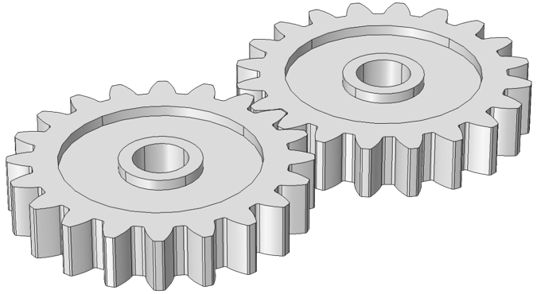
Demo graphs of the Final Data Frame
Initial Data Frame with 45211 data points and 16 feature variables
Feature engineered Data Frame With
45211 by 22 feature variables
Transformation
Customer Centric | Business Centric | Customer Demo graphs
Education | Contact | Age
Job, Marital | Day
Loan | Month, Previous
Default, Balance, and Housing | Duration, Campaign
Dataset Summary:
Total Observations : 45211
Total variables : 22
Split : 80-20
Target Variable : Output binary class
Evaluation Metric : Accuracy
Final Metric : Recall and Precision on seen data

Slide 7
Data Insights

Slide 8
Checking the class imbalance and NO of different type of attributes
Data balancing techniques were included to get the data balanced.
Various techniques are: Over, Under, Smote and Rose Smote.
Data types distribution.

Slide 9
Customers Pattern and Statistics

Slide 10
Descriptive stats of Customers Term Deposit

Slide 11
Business Centric Stats

Slide 12
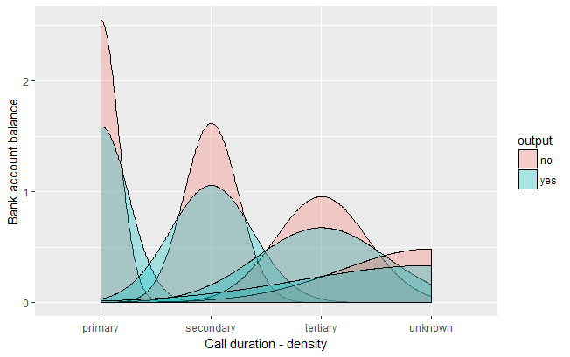
Statistical Duration Patterns

Slide 13
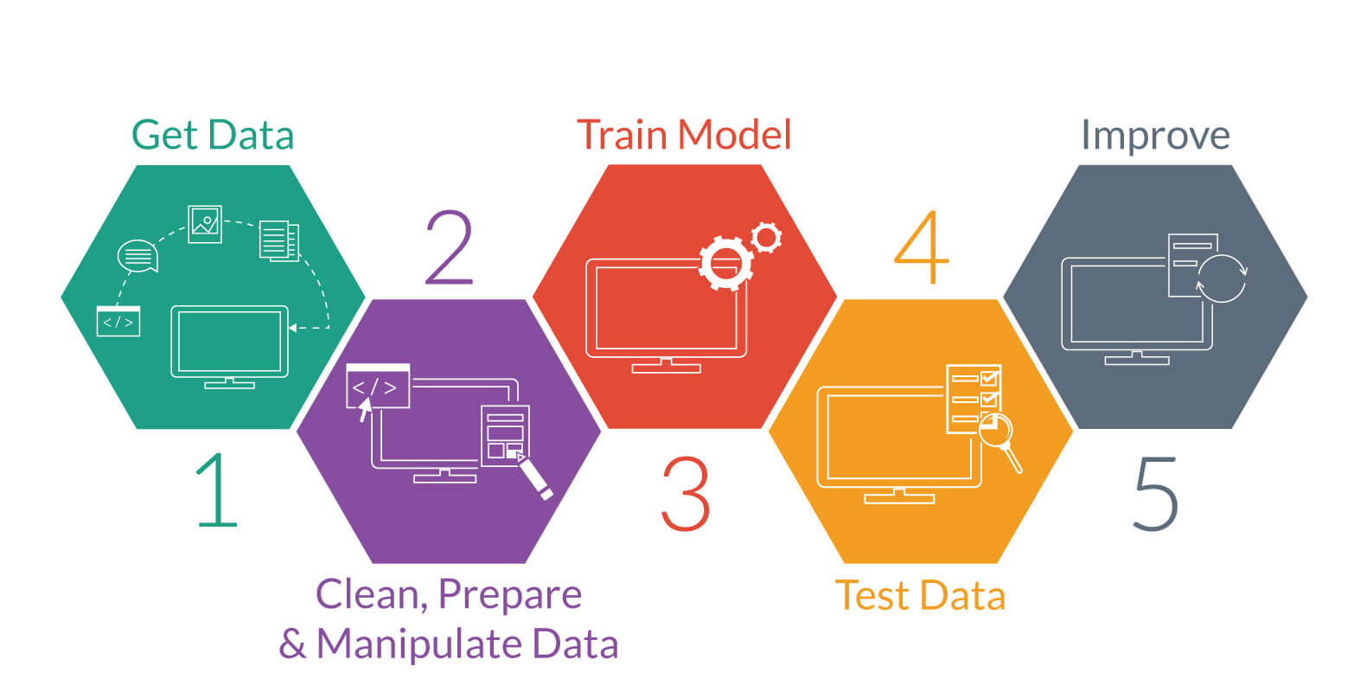
Model Building

Slide 14
Model Building approach Base Line Classification of no and yes Term Deposit
Customer Data Base
MODEL
Yes
Output
NO
Removed variables with more than 22 levels
NO
Input
Predictions
Customer Data Base New
Input
NO
Yes
New Data
NO
Target Labels

Slide 15
Algorithm Comparison

Slide 16
Algorithm Comparison with Balancing Techniques

Slide 17
PATTERN EXTRACTION
By this Pattern Extraction we will get to know which variable are most pre dominated in converting the customer to buy term deposit.
{housing=no,contact=cellular,poutcome=success} => {output=yes}
{housing=no,contact=cellular,previous=Contacted Few days,poutcome=success} => {output=yes}
{default=no,housing=no,contact=cellular,poutcome=success} => {output=yes}
{default=no,housing=no,contact=cellular,previous=Contacted Few days,poutcome=success} => {output=yes}
{housing=no,loan=no,contact=cellular,poutcome=success} => {output=yes}
{housing=no,loan=no,contact=cellular,previous=Contacted Few days,poutcome=success} => {output=yes}
{default=no,housing=no,loan=no,contact=cellular,poutcome=success} => {output=yes}
{default=no,housing=no,loan=no,contact=cellular,previous=Contacted Few days,poutcome=success} => {output=yes}
{housing=no,poutcome=success} => {output=yes}
{housing=no,previous=Contacted Few days,poutcome=success} => {output=yes}

Slide 18
Tools and Hyper parameters used in the model
Logistic Regression: Used the model by Cart and sklearn and with Cross validation and no such hyper parameter used to tune it. Even the threshold was selected using the auc.
Naïve Bayes: Used the model by Cart and sklearn and with Cross validation and no such hyper parameter used to tune it.
Decision Tree: Used the model by rpart and sklearn and with Cross validation and hyper parameters which were tuned are Complexity parameter CP in order to avoid the overfitting of the model by proper pruning.
Ada Boost : Used the Baseline model in R and sklearn and used the Cross Validation with Hyper parameter which where tuned are no of iterations and loss as logistic.
.LDA: Used in base line package of sklearn in python
Random Forest: Used in base line package of sklearn in python
For visualisations Excel, and R ggplot are been used and even python for scripting them us in that also.

Slide 19
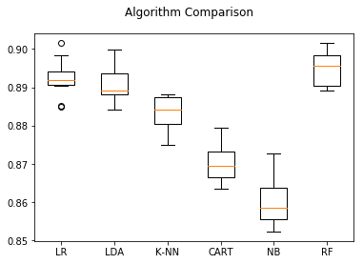
FINAL MODEL SELECTION
Final Model:
Logistic Regression

Slide 20
Variables which are driving the decision
Generally a customer will subscribe a term deposit if,
His/her job type is management or technician or blue colour or admin but management has the high priority.
If he/she is married.
Education is secondary or tertiary.
Has no credit in default.
Average yearly balance is around 1751.3002.
Has no housing loan.
Has no personal loan.
Contact communication type is cellular.
Last contact month is (priority basis) May or August or July or April.
Average contact duration is around 539.5608 second. and if contact duration is above 448 seconds there is
huge conversion rate.
Number of contact to him/her is around 2.1545 times.
Around 69.2306 days passed after the last contact.
Number of contact performed is around 1.2003.
A person who contacted long back cant term deposit
A person with low balance is having high chances of term deposition

Slide 21
SUMMARY
As there is strong urge for the interpretability then we will be going for Logistic regression as it gives more interpretability when compared to other models and even less complex.
Even the Naïve Bayes is not being selected as it doesn’t capture the linear pattern in the data.
The Variables which are driving the decision the most are:
Duration
No Housing Loan
No Default
Contact Cellular
Previous Contacted Few Days Back
Poutcome success

Slide 22
Q&A

Slide 23
THANK You

